Slide 1
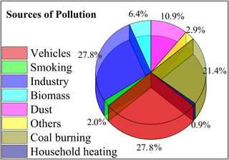
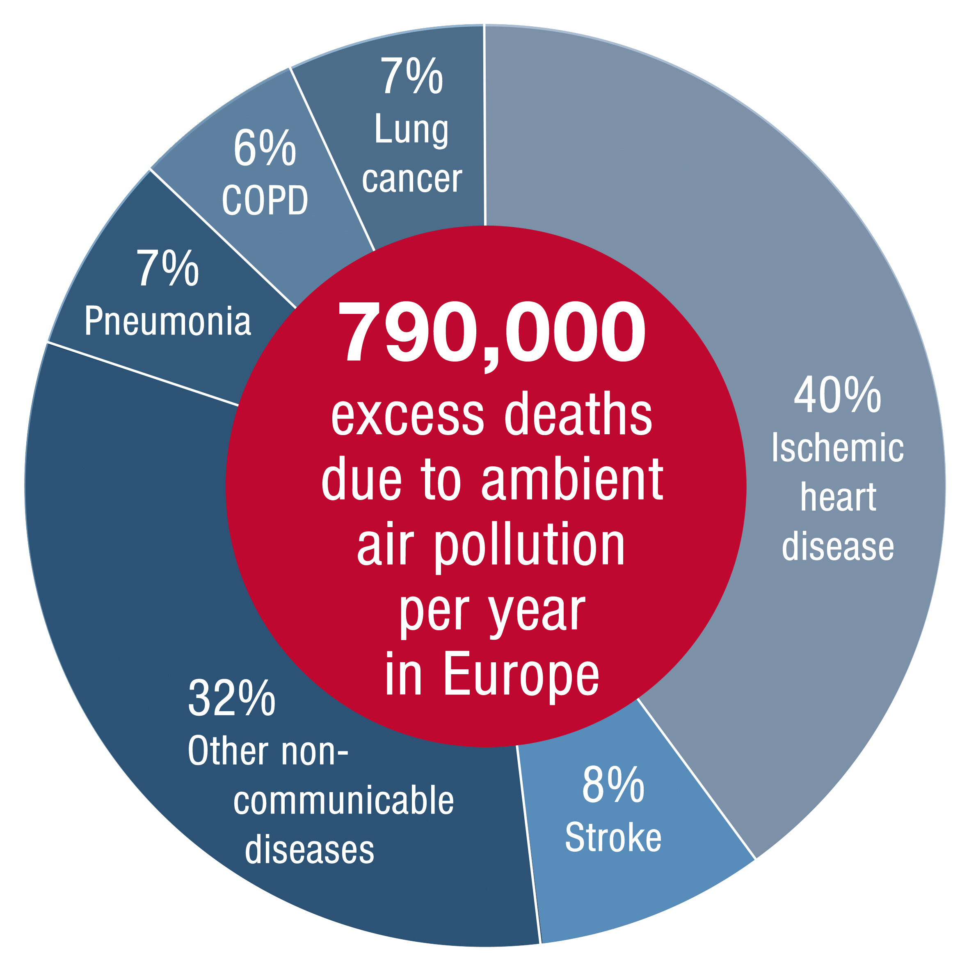
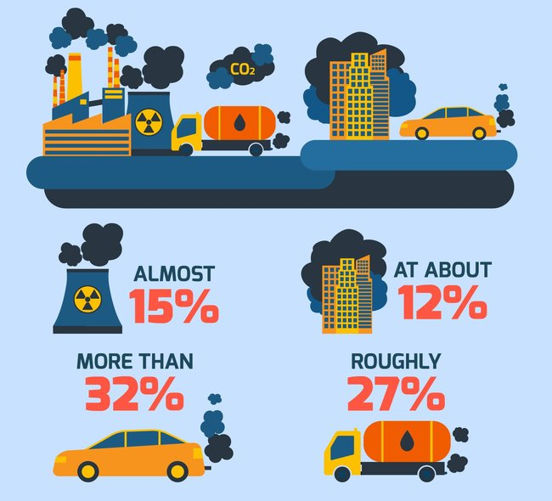
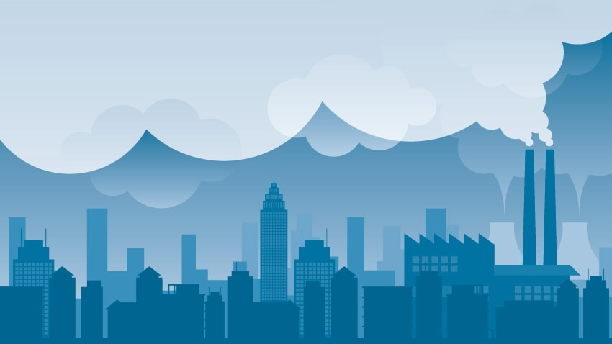
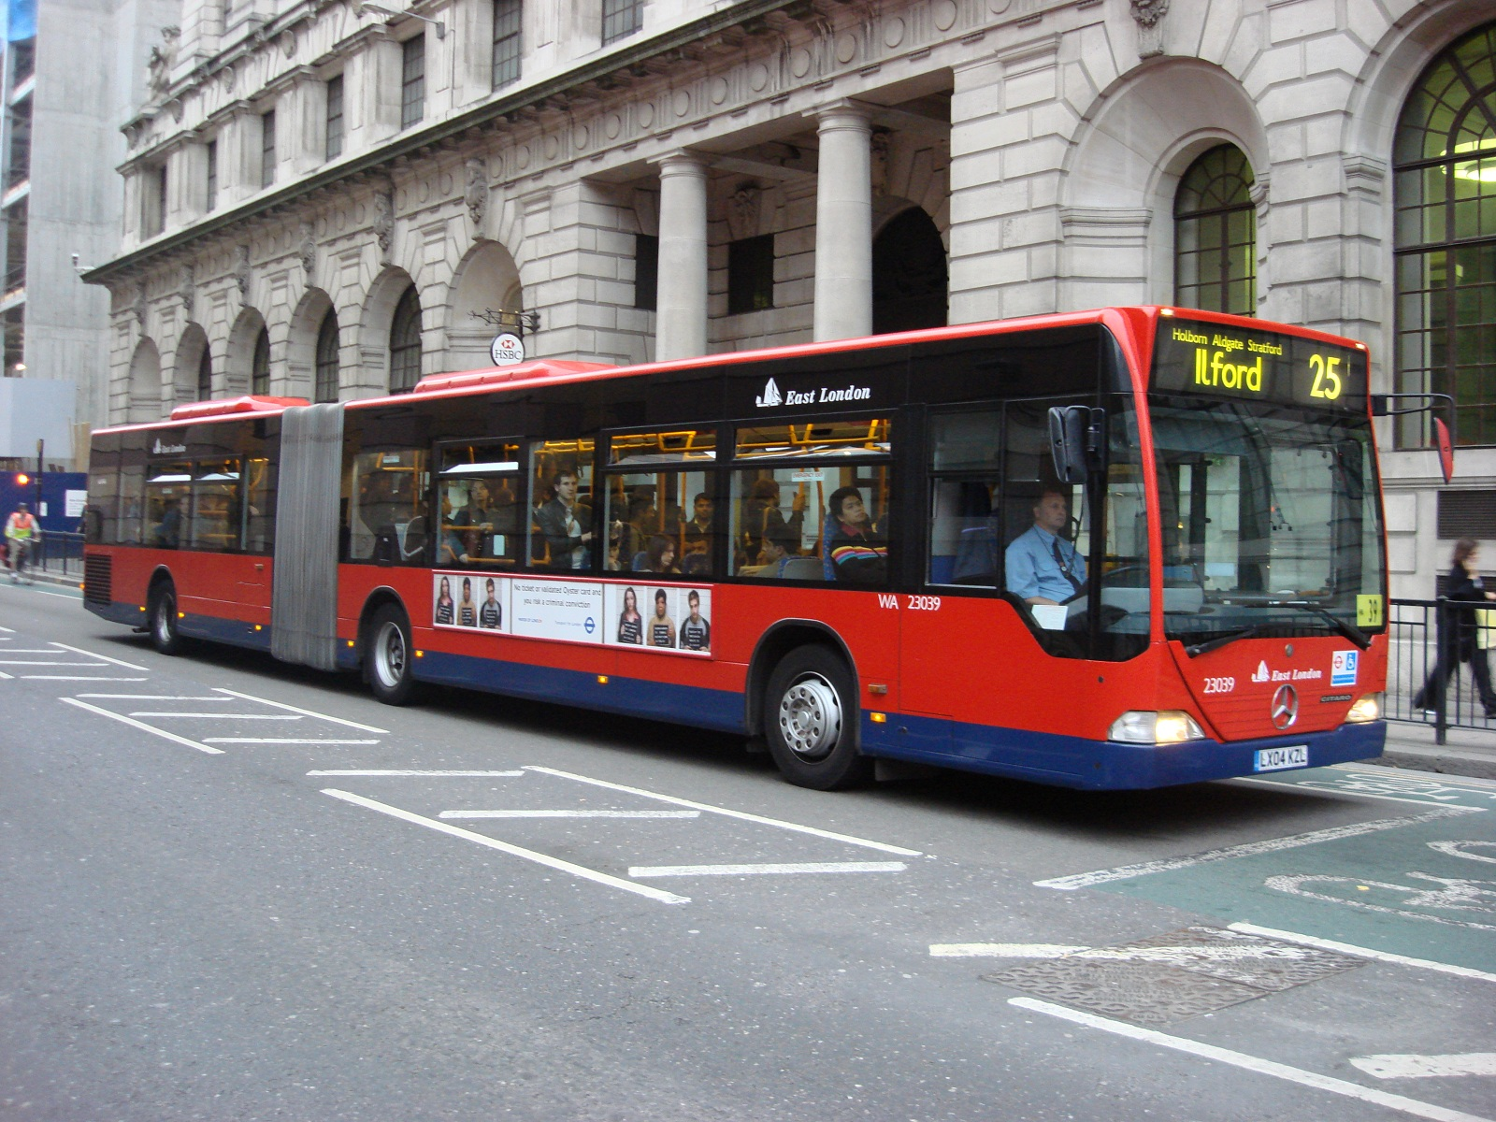





What Is Air pollution?
Air pollution is a mixture of solid particles and gases in the air. Car emissions, chemicals from factories, dust, pollen and mold spores may be suspended as particles. Ozone, a gas, is a major part of air pollution in cities.
Various Causes of Air pollution
The burning of fossil fuels
Agricultural activities
Exhaust from factories and industries
Mining operations
Indoor air pollution
Air pollution
Types of Pollutants
Solutions For Air Pollution
Primarily air pollutants can be caused by primary sources or secondary sources. The pollutants that are a direct result of the process can be called primary pollutants.
Use public mode of transportation
Conserve energy
Understand the concept of Reduce,
Reuse and Recycle
Emphasis on clean energy resources
Use energy efficient devices
Secondary pollutants are the ones that are caused by the intermingling and reactions of primary pollutants. Smog created by the interactions of several primary pollutants is known to be as a secondary pollutant.
Name: Soy Trikea, Kung Ysoes and Lor Chansoreya

